Slide 1
Estimating and Interpreting Video Game Sales
Noah Sutherland, Gavin Sorenson, Parker Seehafer

Slide 2
Our Question
If someone is looking to publish their own game, how could preexisting Steam data be examined to accurately set the price?

Slide 3

What we analyzed
This Photo by Unknown Author is licensed under CC BY-SA
We analyzed sale data from a CSV, which contained data from the company Steam. Steam is a popular store hub for video games, and is widely regarded as the “only option” when it comes to downloading popular games on a computer. This CSV contained details about each title like Genre, Average Playtime, DLC Counts, Date Released, and many more.

Slide 4
What did we do?
We analyzed nearly 90,000 titles in this CSV file, to be able to give an accurate prediction about how price affects how a game is perceived by the public.
We used filtering functions to create accurate data.
We created graphs comparing price, and other variables that make sense for our project.
We diminished bias within our data to create accurate inferences about price.

Slide 5
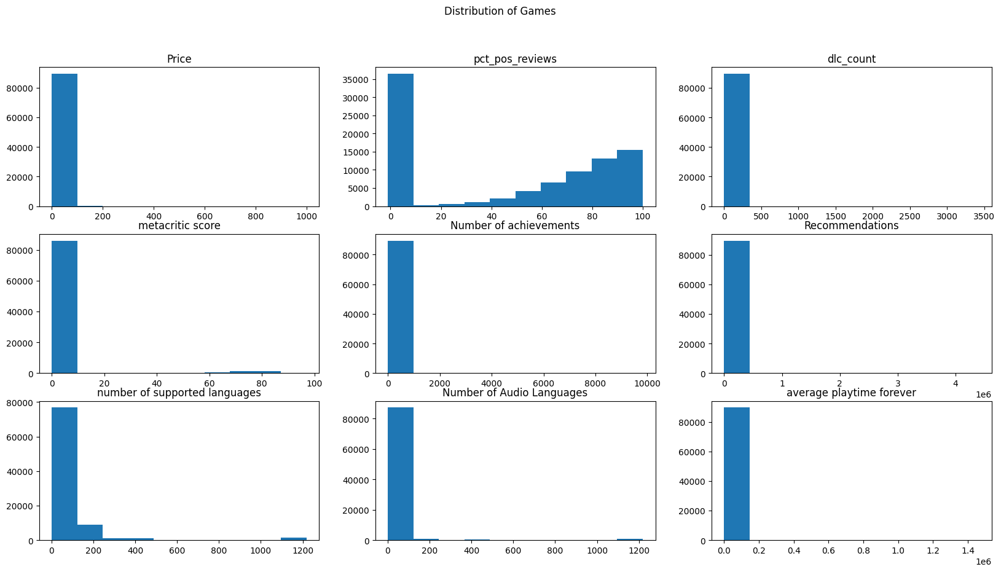
Exploratory Data
First, I did some exploration of the data to see if there was any data that we could use for our prediction.

Slide 6
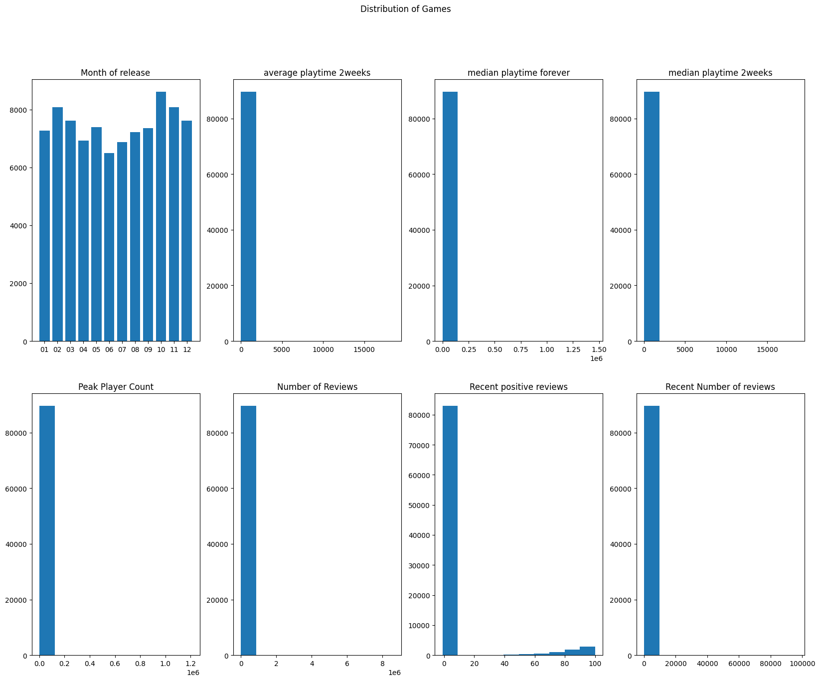
Exploratory Data Continued

Slide 7
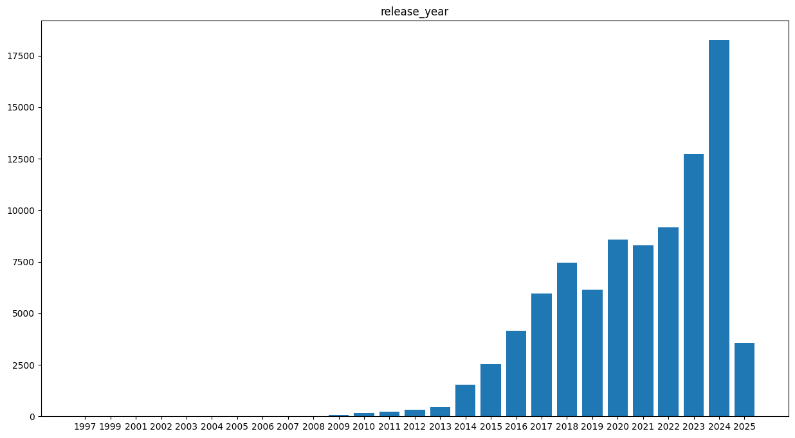
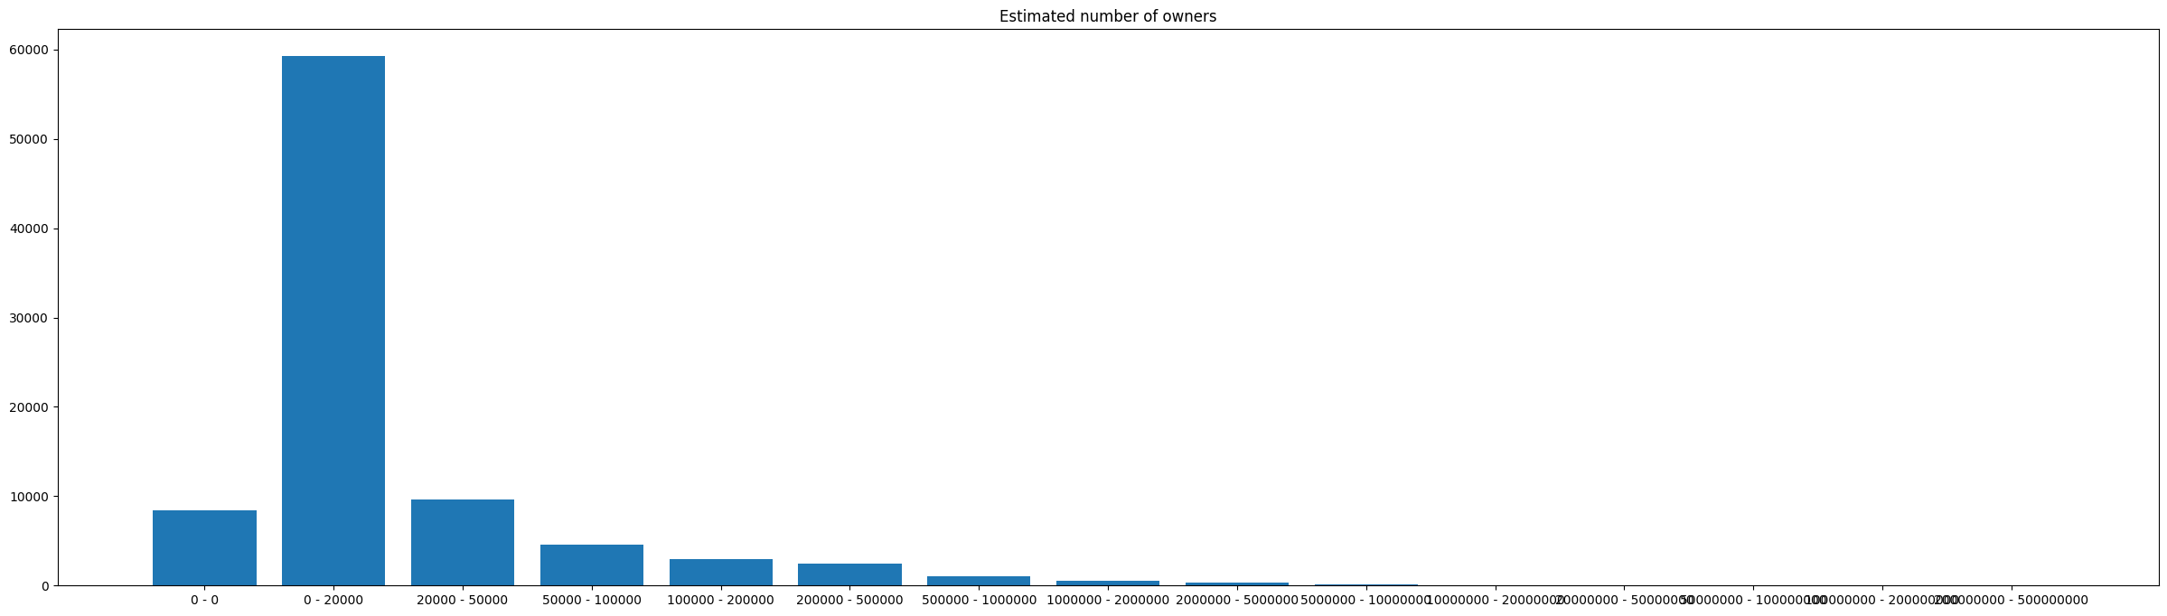
Exploratory Data Continued
From this initial data it was clear that we were going to need to do some more cleaning and possibly transforming of the dataset to get predictions to work out.

Slide 8
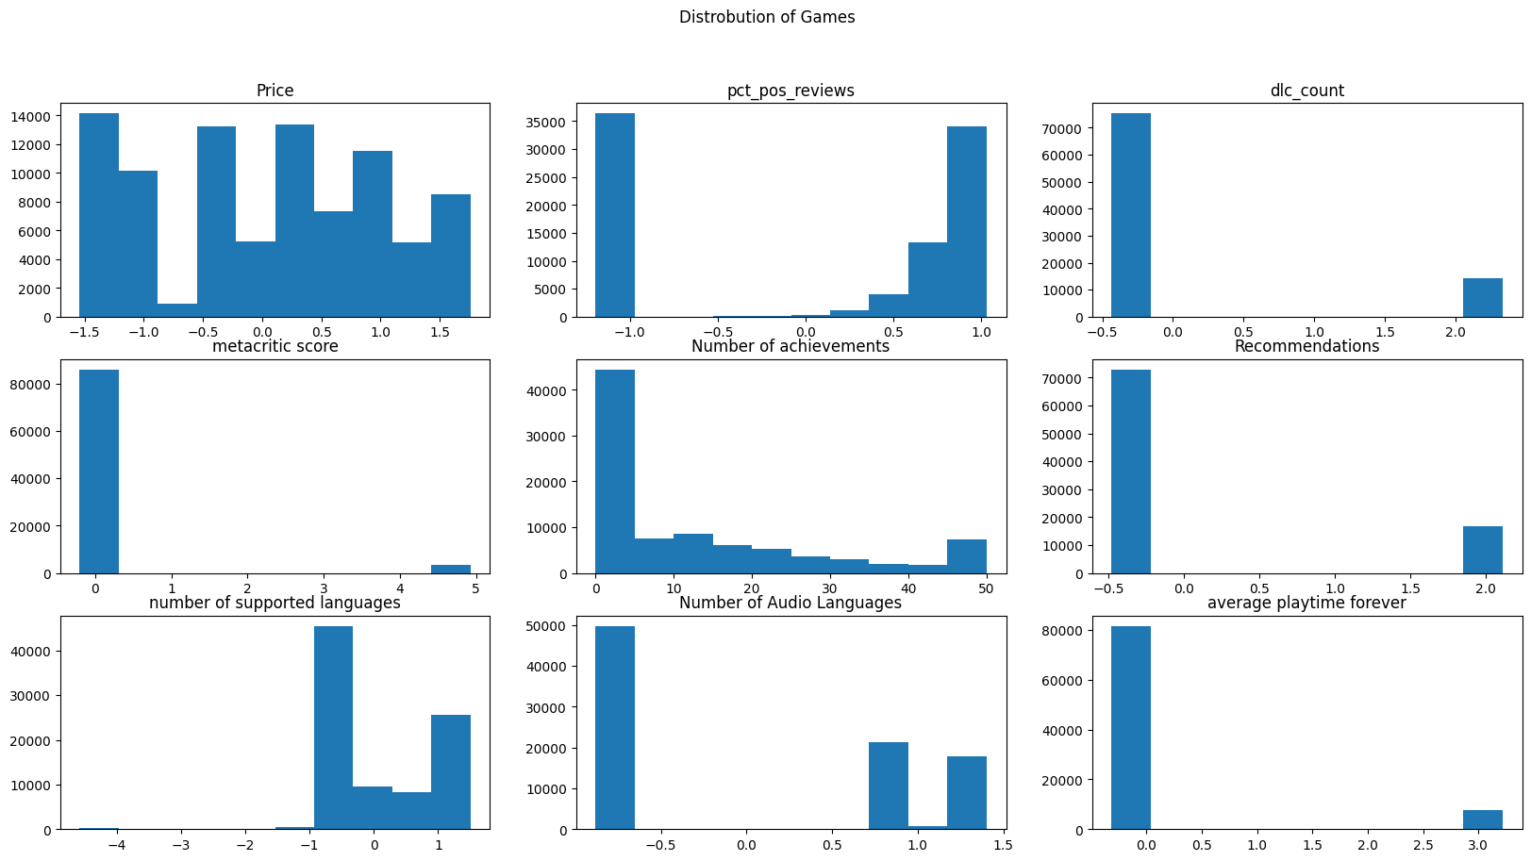
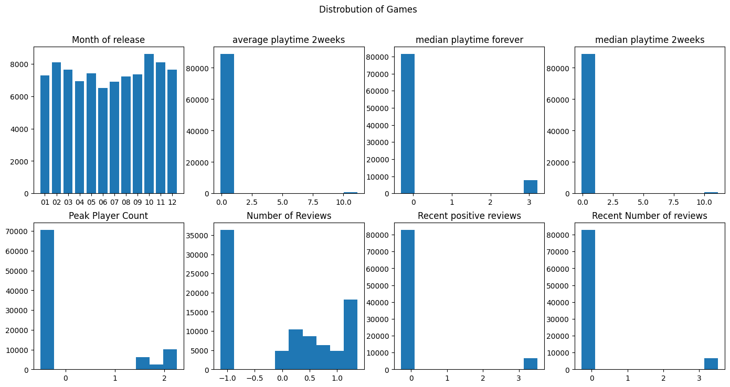
Cleaning data
I landed on just doing a log transformation on the data and then removing the outliers. But price was probably the only point that we could use.

Slide 9
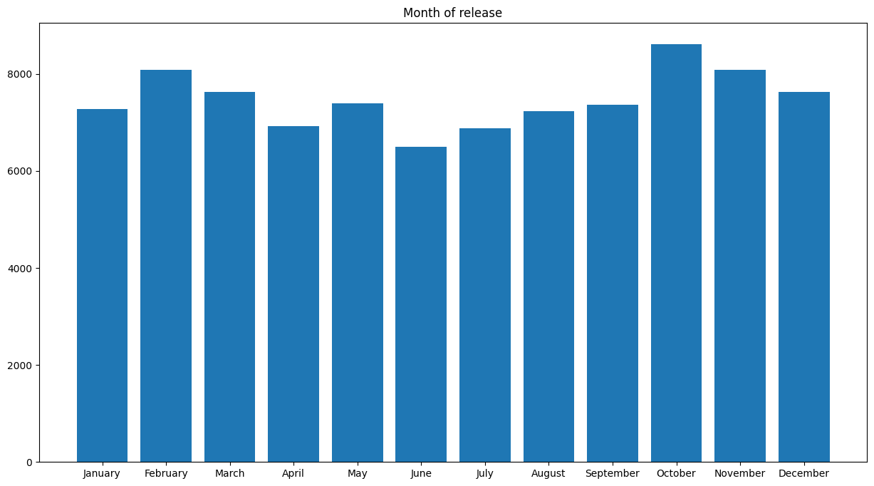
Distribution of Games During what months
Looking at the distribution of the Games released in each month it is very normal.
Notes:
Gavin this is the one that you had requested

Slide 10
Predicting Prices with the Release Month
release_month_name | predicted_price_USD | actual_price_USD
January | 3.72 | 3.70
February | 3.86 | 3.89
March | 3.97 | 3.96
April | 3.85 | 3.88
May | 3.82 | 3.79
June | 3.78 | 3.80
July | 3.81 | 3.82
August | 3.83 | 3.82
September | 4.23 | 4.23
October | 4.19 | 4.19
November | 4.14 | 4.14
December | 3.75 | 3.78
R2 Value: 0.0011215150913588268
Root Mean Squared Error: 1.0013022406779024
P-Value: 1.290371e-16

Slide 11
Paid Games vs Release Month
release_month_name | predicted_paid_games | actual_paid_games
January | 4.98 | 5.01
February | 5.24 | 5.23
March | 5.24 | 5.23
April | 5.18 | 5.24
May | 5.34 | 5.40
June | 5.34 | 5.36
July | 5.41 | 5.37
August | 5.42 | 5.39
September | 5.63 | 5.68
October | 5.68 | 5.62
November | 5.55 | 5.57
December | 5.28 | 5.23
R2 Value: 0.0010824554290765898
Root Mean Squared Error: 0.9944952327348858
P-Value: 1.676634e-16

Slide 12
Conclusion about Price
Highly skewed towards free games
Even with free games removed from prediction we still get very low values
Low values most likely from dataset having mean of around $7 for the price
Seeing an effect of games priced higher than $25 getting capped
If I had more time I would have liked to clean the other datasets and do multiple linear regression

Slide 13
Analyzing Price by Genre
Hypothesis
𝐻0: The genre will not affect the price of the game and all genres will have a similar price.
𝐻𝐴: The genre does affect the price of the game and every genre will have a varying price.

Slide 14
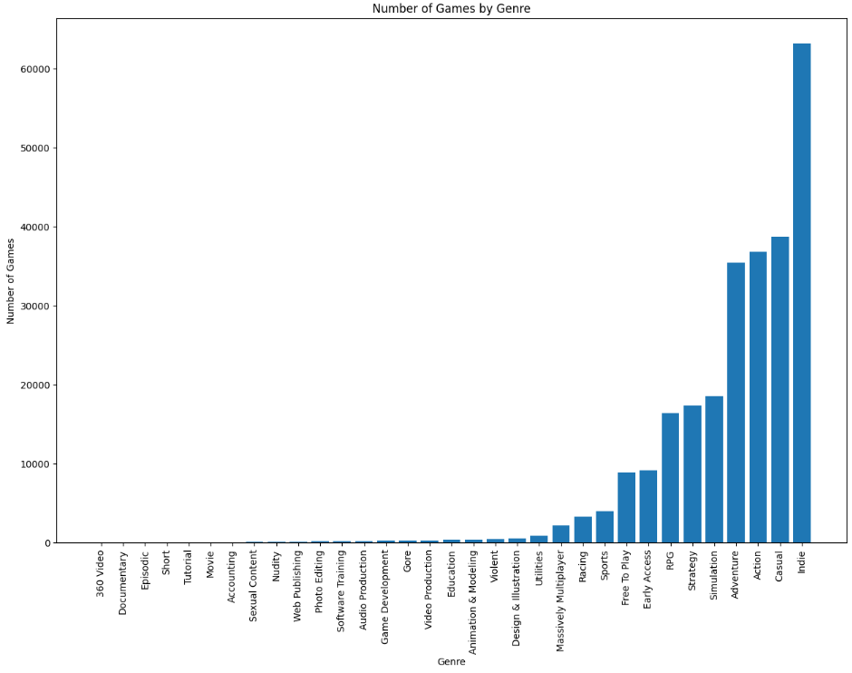
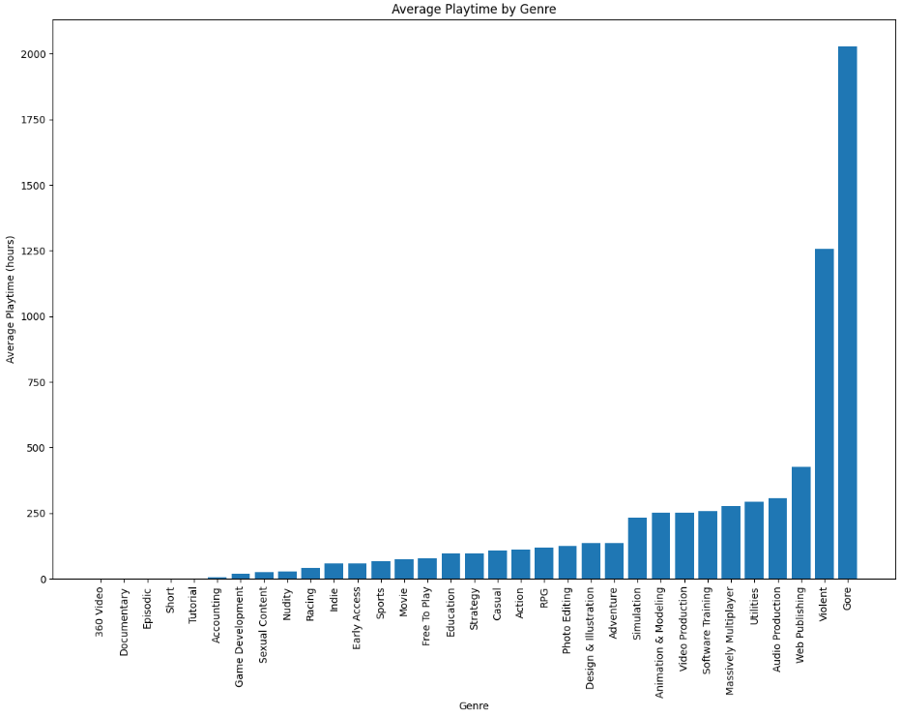
Average Playtime vs. Game Count
Notably, Violent and Gore Categories seen the highest average playtime, while ranked extremely low in the number of games.
Indie sees the highest number of games, followed by Casual and Action.

Slide 15
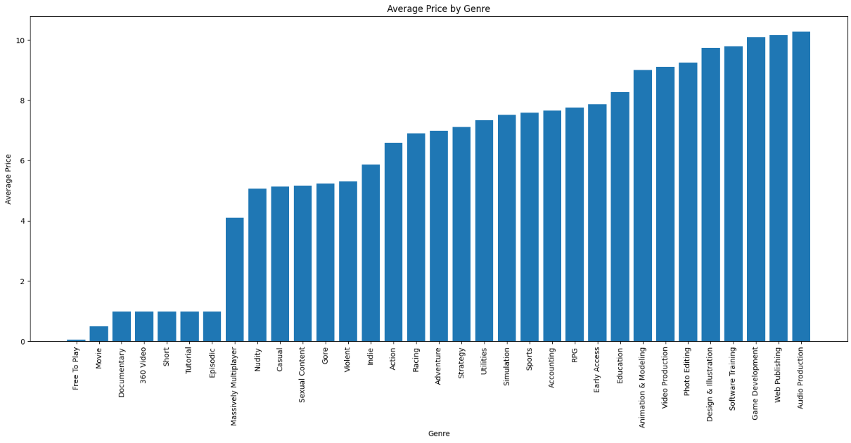
Price and Genres
Filtered Outliers from Price to remove large skew
Most games have more than one Genre
Explode the DataFrame
Plotted Sorted Average Price by Genre
Notes:
Noah this is the one that you had requested

Slide 16
Price Trained by Genre
 | genres | predicted price | actual price
0 | Action | 6.606517 | 6.587199
1 | Free To Play | 0.045044 | 0.051928
2 | Adventure | 6.983657 | 6.988375
3 | Massively Multiplayer | 4.226260 | 4.092967
4 | Strategy | 7.159926 | 7.108784
5 | Indie | 5.843881 | 5.871920
Trained the DataFrame in a user defined linear regression function.
Uses Sklearn module to create a regression model of a numerical column based on a categorical column passed into the function.
Predicts the Price given a Genre
Notes:
Noah this is the one that you had requested

Slide 17
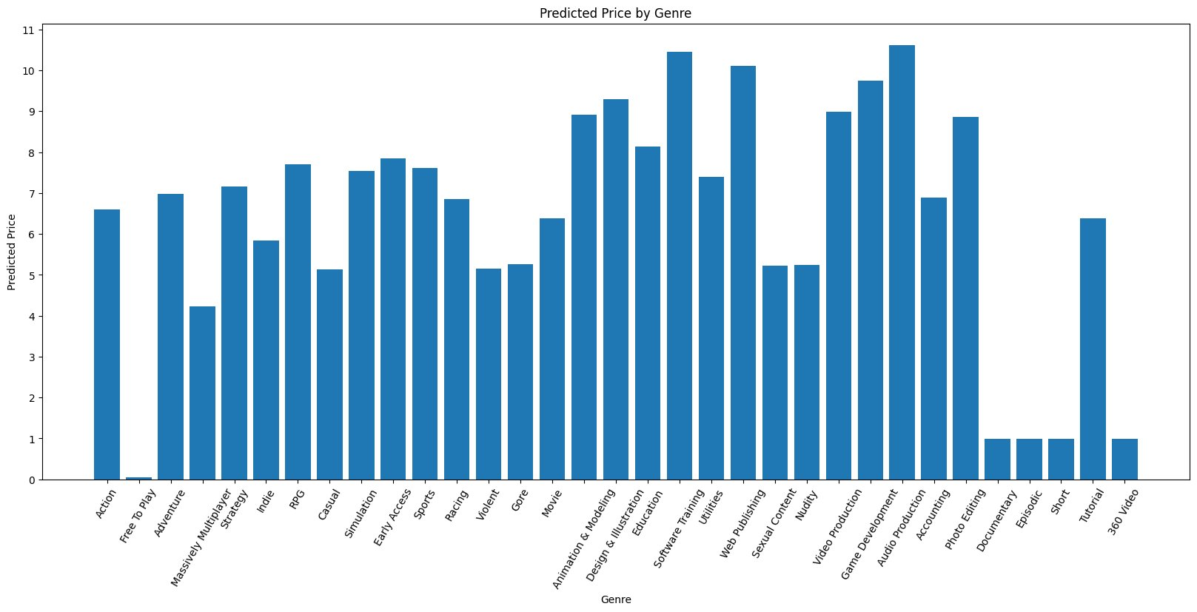
Price and Genres
Notes:
Noah this is the one that you had requested

Slide 18
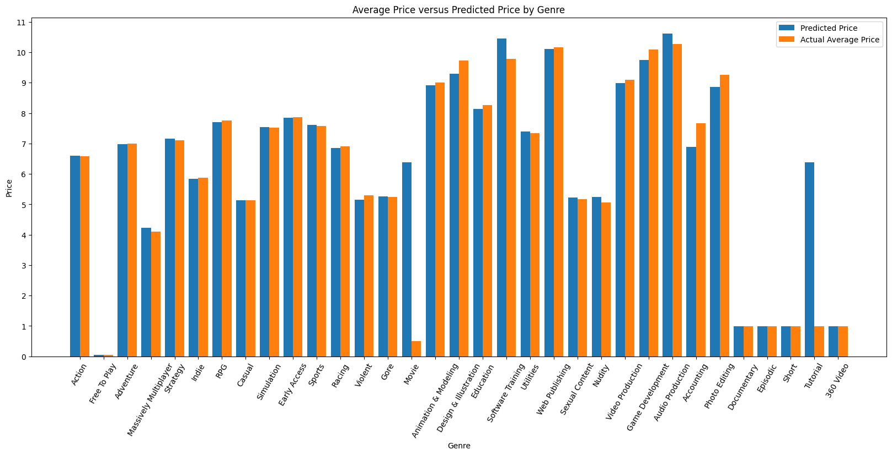
Predicted Price vs Actual Avg Price
Notes:
Noah this is the one that you had requested

Slide 19
Conclusion about Genre vs Price
Model predictions are fairly close to the average Price per Genre (what we expect)
P-Value nearly zero, reject the null hypothesis that price is same over the genres
Correlation remained low between Genre and Price
Need other data tangent to Genre to build a better prediction model

Slide 20
Does Price Dictate the Number of Reviews and How Positive They Are?
Null Hypothesis: The price of the game will not matter, and the games will get reviewed the same.
Anti-Hypothesis: The reviews will be affected based on how much the user paid for the game.

Slide 21
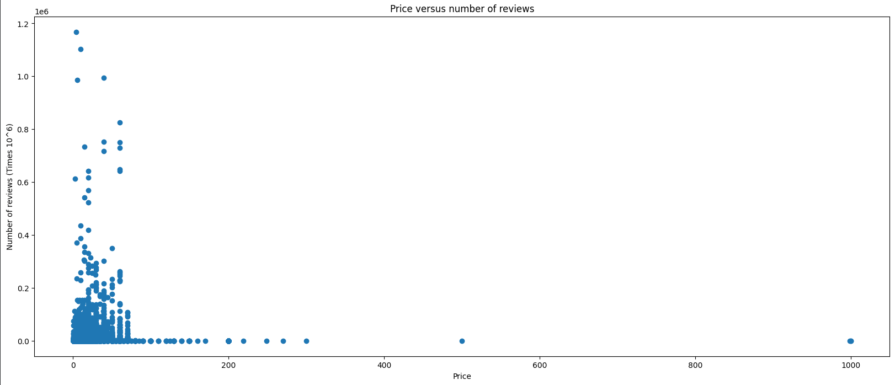
Total Number of Reviews
This chart compares the total amount of reviews given to a game, versus the pric3e of the game. The reason we create this chart to look at it because it not only shows us the relationship between the two, but also the willingness of the user to leave a review on a game they paid money for.
Notes:
We can see a clear skew to the right, where most of the data is bunched up to the left. This is because the x-axis, shows us there aren’t many games with a price of over 200 dollars.
This makes sense because not many people would pay 200 dollars for something intangible.

Slide 22
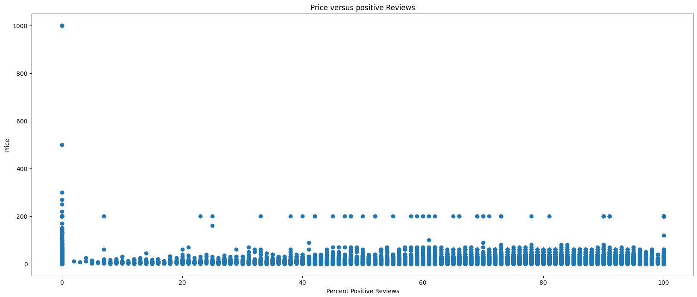
Percent Positive Reviews
This graph shows us the relationship between Price and Positive Reviews for the game, where price is the y variable, and Percent Positive Reviews is the x variable. It is skewed slightly towards the top because of the few outlying games that cost over 300 dollars.

Slide 23
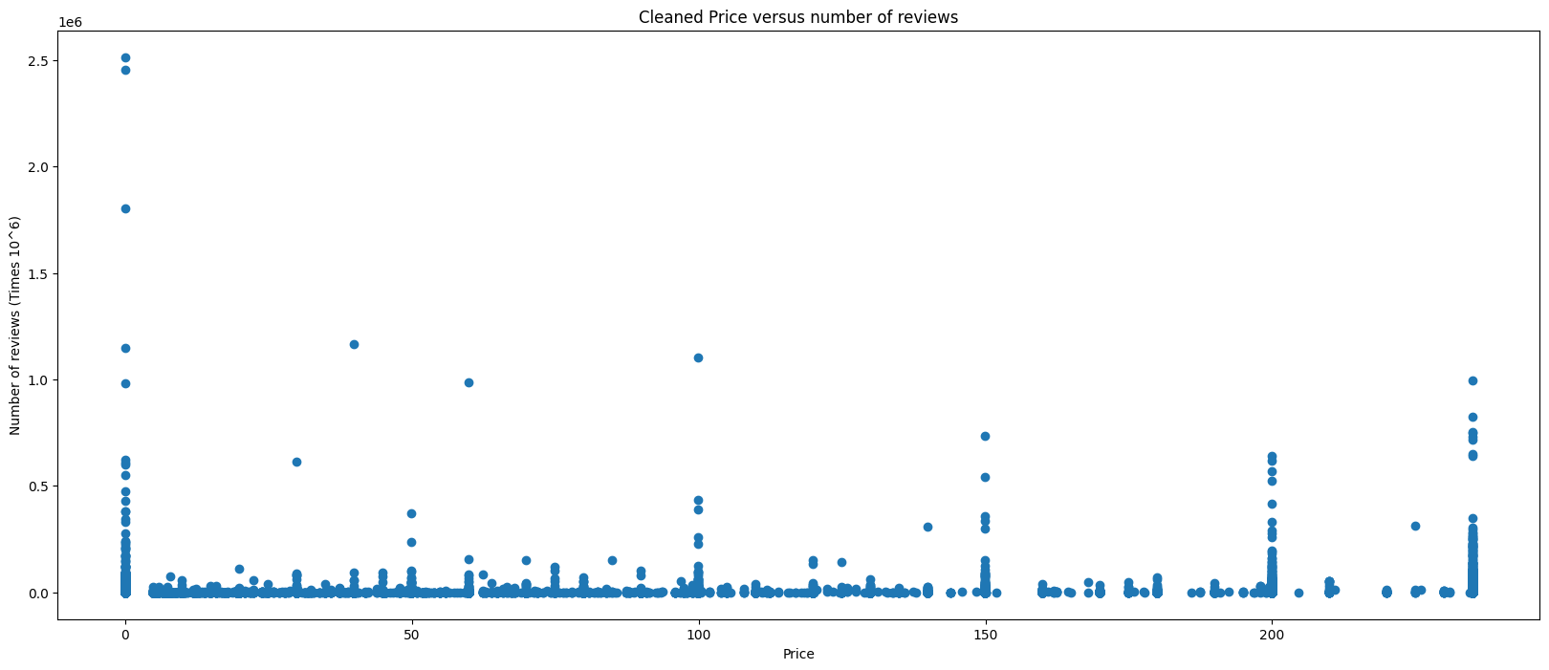
Cleaned Total Number of Reviews
After cleaning the data, we can see a clear change in the Price vs. Number of reviews chart. Everything is much more spread out and paints us a better idea to start making predictions about the data.

Slide 24
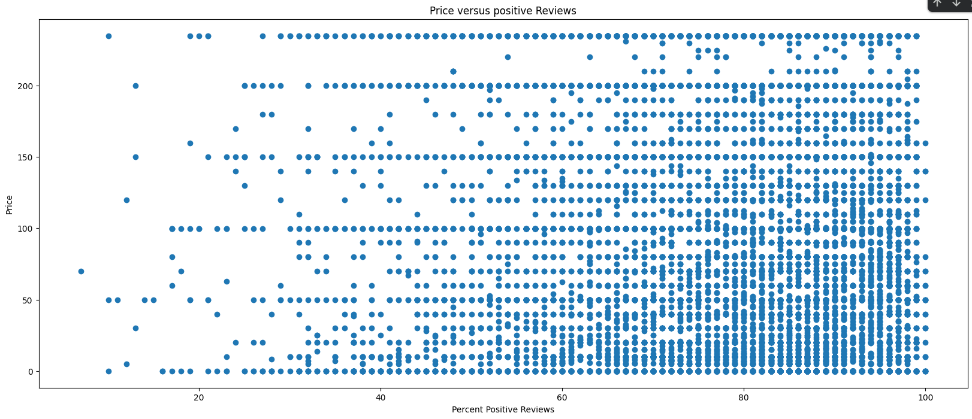
Cleaned Percent Positive Reviews
This graph is much easier to read after the data has been cleaned. We can see a clear skew to the left which is to be expected because reviews tend to be more positive than negative. As well as a denser cluster of data points in the lower left corner, because there are more games that are cheaper than there are expensive, and there are more positive ratings than negative ones.

Slide 25
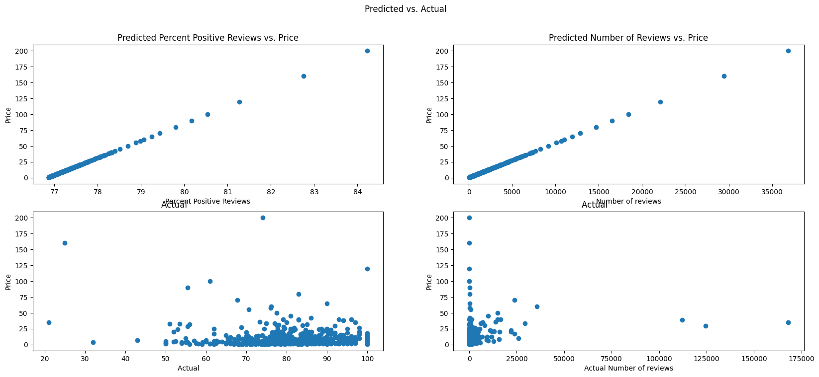
Predicted vs. Actual
We can see a clear positive relationship for the predicted values, where if price is higher the reviews for the game will be higher. When the actual is computed we can see that they are similar. If we look at where the charts are the densest, we can see that they are accurate to the data we’ve found.

Slide 26
Conclusion
Null Hypothesis is True
The amount of money does NOT affect how much users review the game
Unsurprisingly, free games get reviewed the most
We can predict, that if the user either spends no money, or over 200 dollars on a game, they are likely to review it the same amount.

Slide 27
Future Analysis
Transforming more of the datasets so that we can perform multiple linear regression
Scrape data from SteamAPI for pricing data on other countries
Get more about the type of game company

